Slide 1
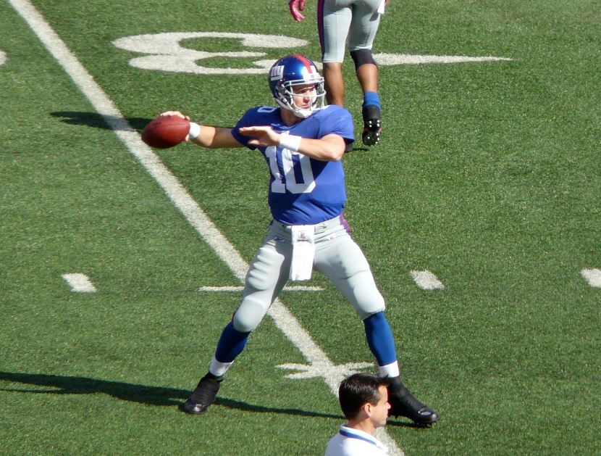
Predicting NFL Game Outcomes
Data Science Certificate - Cohort 17 - Georgetown University
Peter Coiley, Chris Hurd, Chris Whitcomb

Slide 2





Agenda
Research and Inspiration
Data Ingestion and Wrangling
EDA and Feature Analysis
Modeling and Application
Future Work and Beyond

Slide 3

Research and Inspiration

Slide 4

Background Research
The NFL’s Analytics Revolution has Arrived
"Football is still well behind baseball and basketball when it comes to embracing advanced metrics, but teams have made significant progress in recent years. Those who do not adapt will be left behind”
- theringer.com
“The point we made with our coaches is: We have all this information but so does everyone else. What advantage does it give us to get it? None. It’s what we do with it, the way we use it.”
- Kevin Colbert, Steelers general manager

Slide 5
Hypothesis and Motivation
Motivation
Professional sports are increasingly relying on advanced data analytics and machine learning to provide an edge that will increase their chance of winning.
Business Purpose
Build a data product that can accurately predict the results of NFL games
Hypothesis
Using data from NFL games between 2002 - 2018, we attempted to determine which features and attributes related to NFL game data best predicted a winning outcome.
Selected our features from game data that consisted of results from previously played matchups.

Slide 6






Data Science Pipeline
Data Ingestion
25,995 JSON files
Data Storage
PostgreSQL
AWS
Wrangling
PostgreSQL
Python
Pandas
EDA /Feature Analysis
Pandas/Numpy
Yb
Modeling and Application
Scikitlearn
Model Evaluation
Reporting and visualization
Yb
Future Work
Ingest new data
More modeling
Widget

Slide 7


Data Ingestion & Wrangling

Slide 8








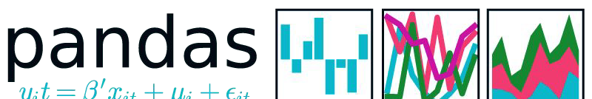



Our Data Science Toolkit

Slide 9

Dataset
Instances: 1,062,249
Seasons: 69
Games: 14,176
Players: 25,995
Size: 1.15GB

Slide 10

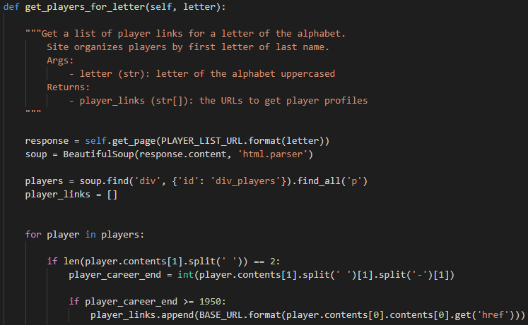
Data Ingestion, Storage, & Wrangling Process

Slide 11




Data Wrangling
Merging Data | Organizing Data | Feature Engineering | Encoding
Transformed our data from 25,995 json files into 1 PostgreSQL table. | Summed key values to convert player statistics into team statistics Split games into teams, home team and away team. Brought home team statistics and away team statistics together into 1 table. | Used game statistics as a base to create team averages. Used team averages to develop novel features: Winning %, Point Differential, Turnover Differential, and Power Ranking | It was necessary to convert multiple fields in our data frame from strings values to numeric values.

Slide 12

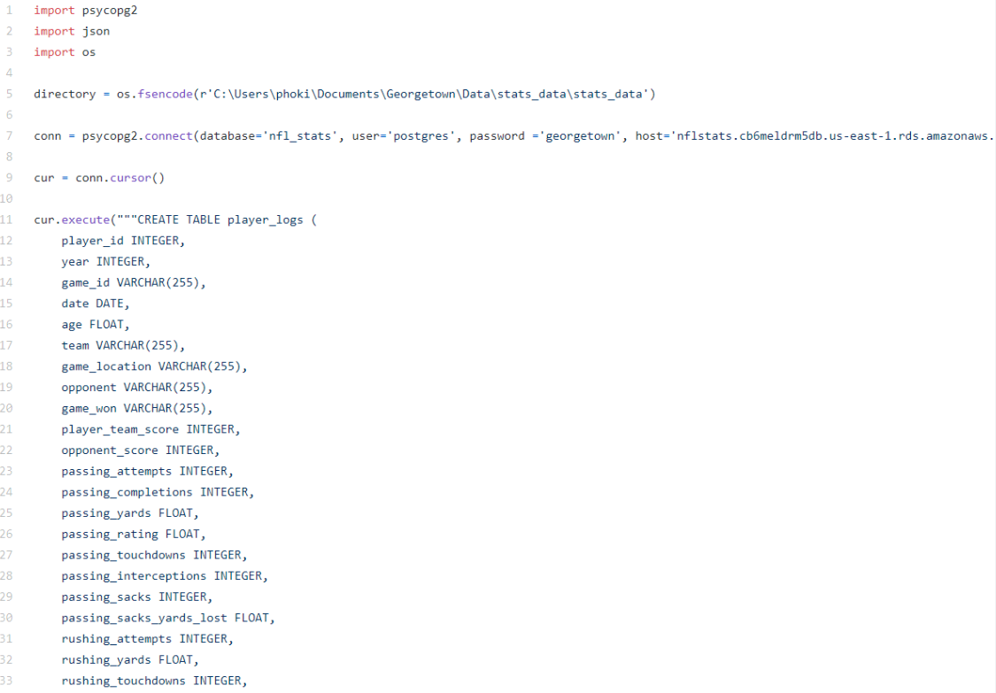
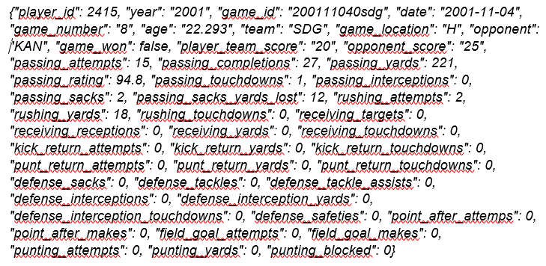
Merging the Data

Slide 13
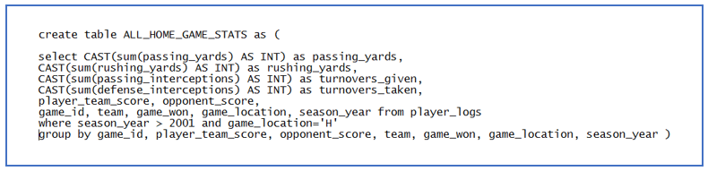

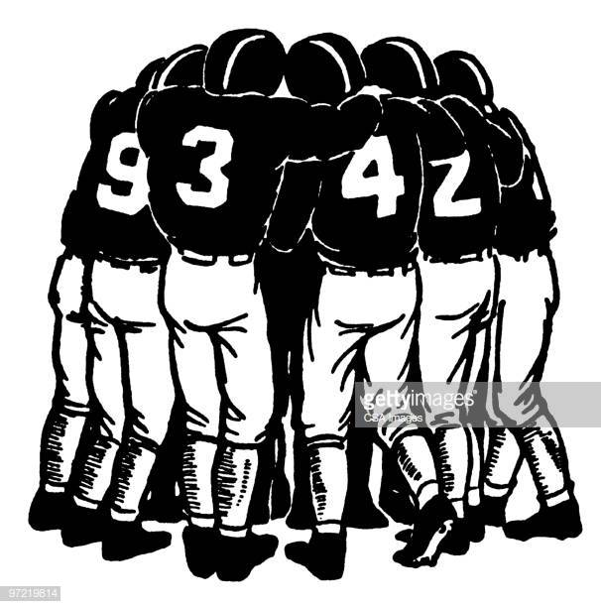


Organizing the Data
Summed Player Date into Team Data, Split Games Into Teams, Brought Everything Back Together…
VS

Slide 14
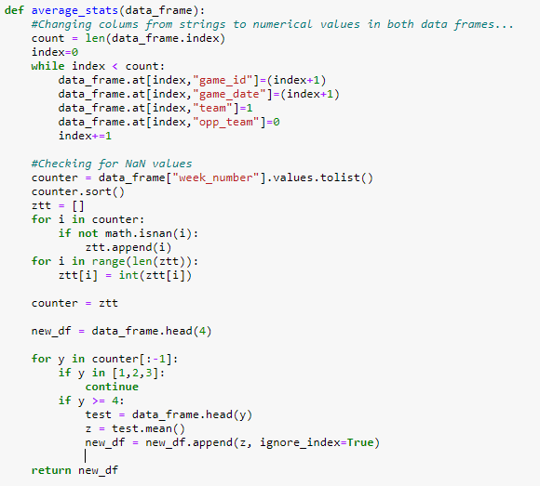
Feature Engineering
Sample Code
Transformed teams’ game statistics to teams' average statistics. This allowed us to base an instance off of how teams had been performing through a specific point in their season.
Developed novel features to enhance and strengthen our model’s performance.

Slide 15
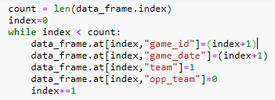

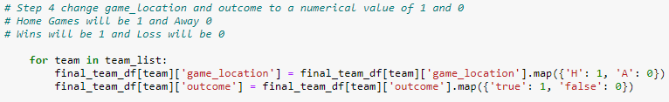
Encoding
Sample Code
It was necessary to convert multiple fields in our data frame from string values to numeric values.
We did this in multiple ways:
- pandas.DataFrame.at
- pandas.DataFrame.map()
Our largest hurdle came with encoding NaN values!
DEN[ 1. 2. 3. 4. 5. 6. 7. 8. 9. 10. 11. 12. 13. 14. 15. 16. 17. 18. nan]
DEN[ 1 2 3 4 5 6 7 8 9 10 11 12 13 14 15 16 17 18]

Slide 16
Exploratory Data Analysis

Slide 17
Exploratory Data Analysis Process
Iterative Process
From raw data, developed initial feature set
Extracted data into Jupyter notebook for initial EDA and initial feature exploration
Developed novel features into new model feature sets
Examined data and new features
Developed final feature set
Final EDA modeling and feature exploration

Slide 18
Initial Data Analysis - Overview
Core Features for each team:
Rushing Yards For
Rushing Yards Against
Passing Yards For
Passing Yards Against
Point Differential
Turnover Differential
Power Ranking
Winning Percentage
Started with 22 features – including rankings and novel feature “power ranking”
Based on initial anaylis decided to combine multiple features and created 2 new features point differential and turnover differential.

Slide 19
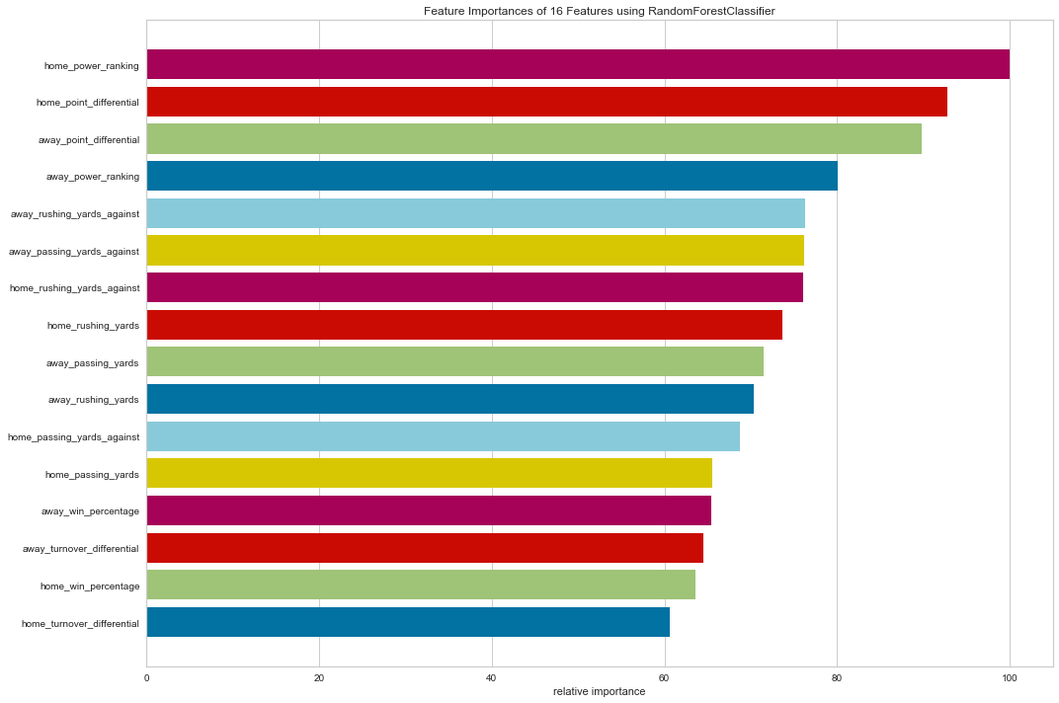
Feature Importance – Random Forest

Slide 20
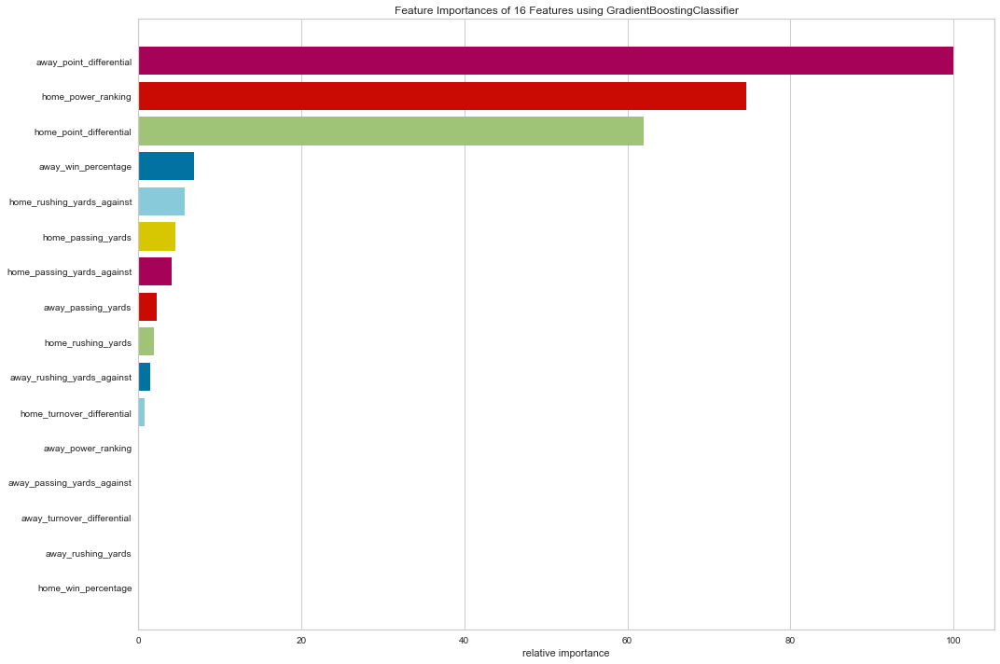
Feature Importance – Gradient Boosting

Slide 21
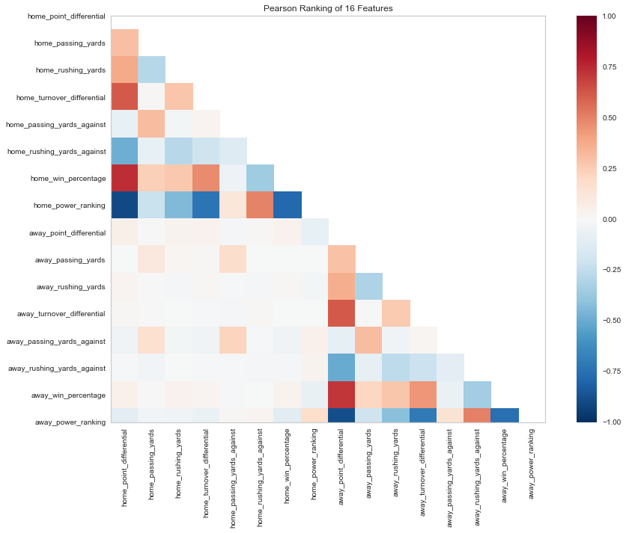
Feature Analysis – Pearson’s Correlation for Random Forest

Slide 22
Feature Analysis – Pearson’s Correlation for Gradient Boosting

Slide 23

Modeling & Application

Slide 24
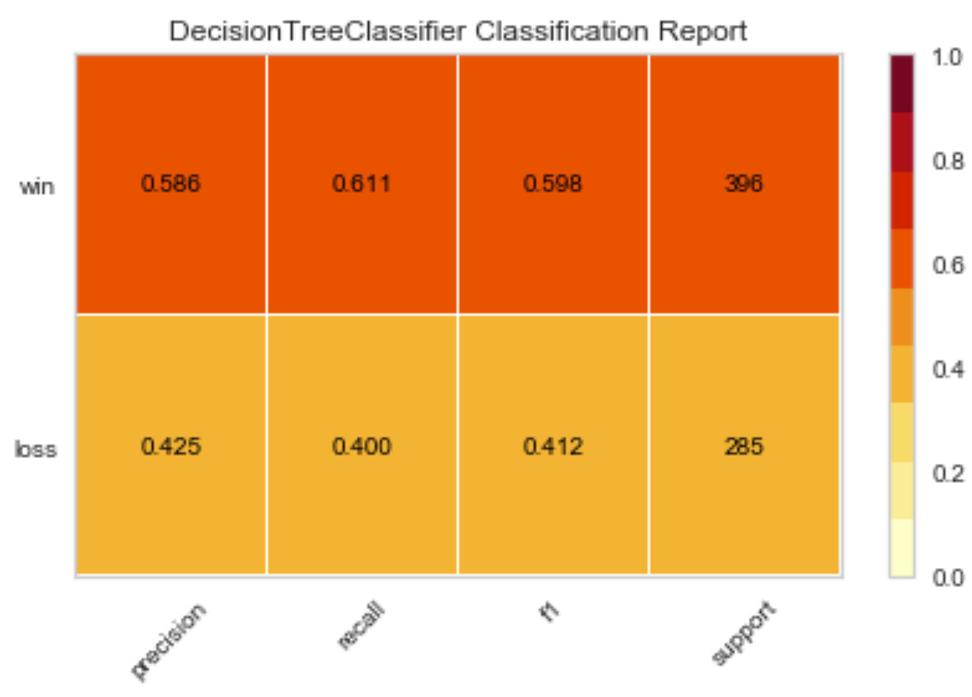
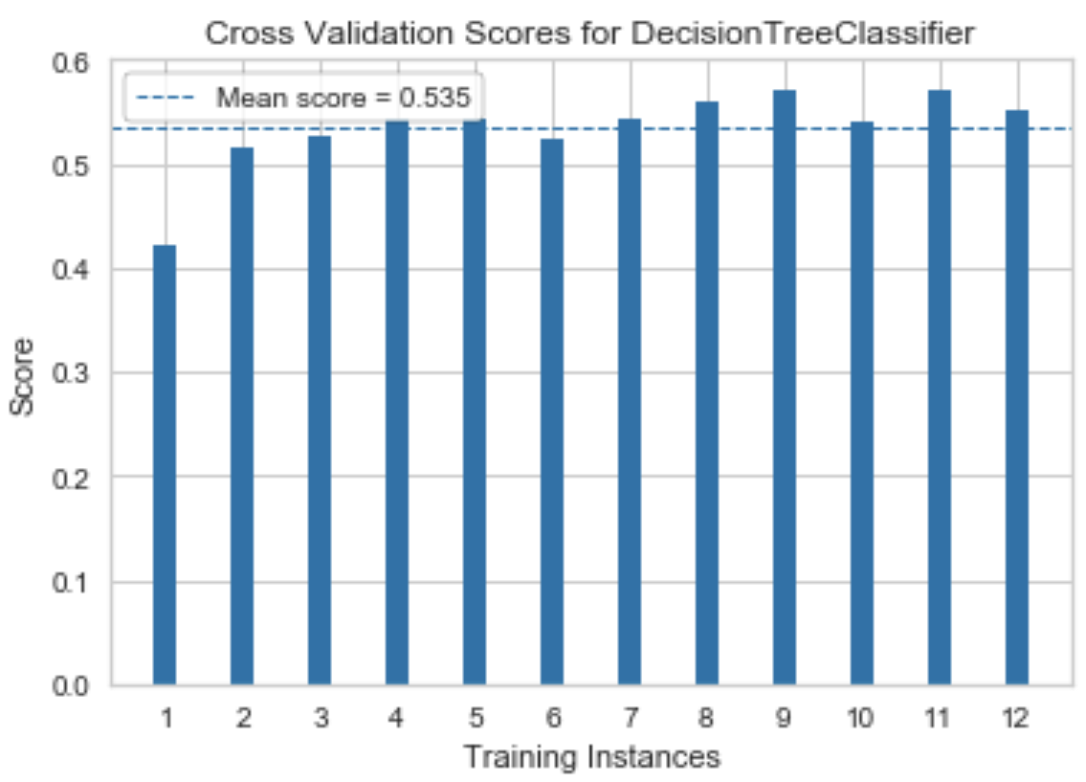
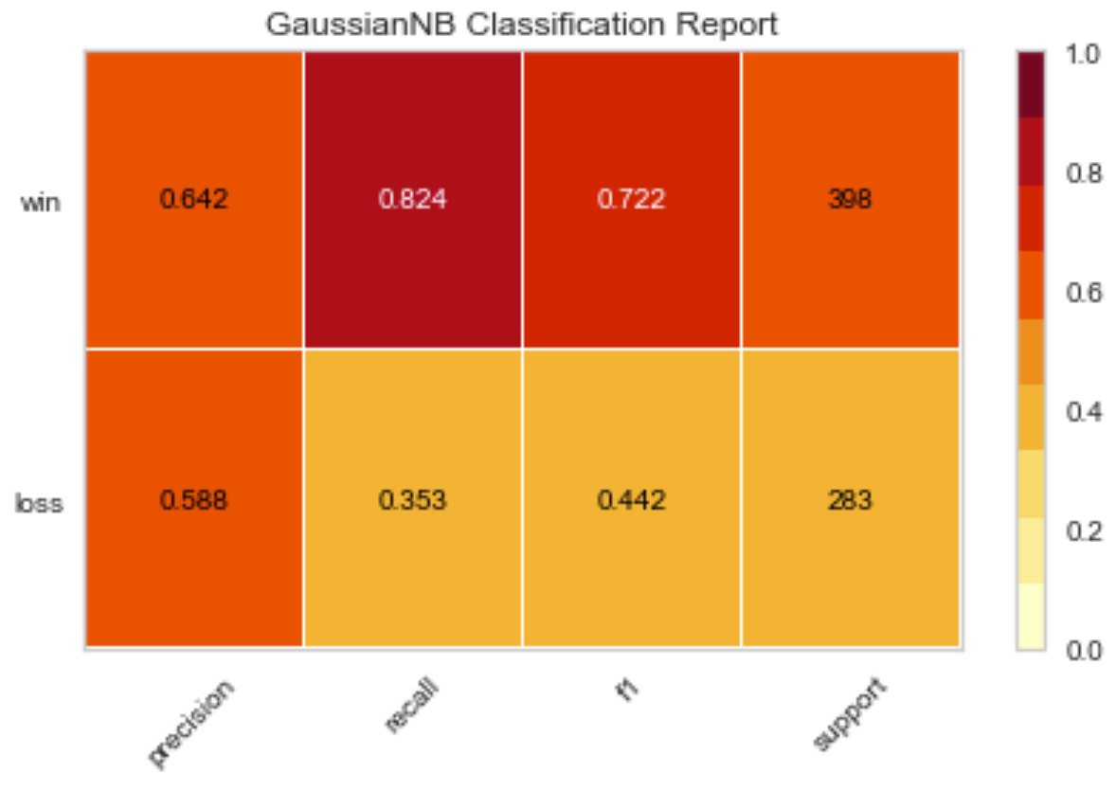
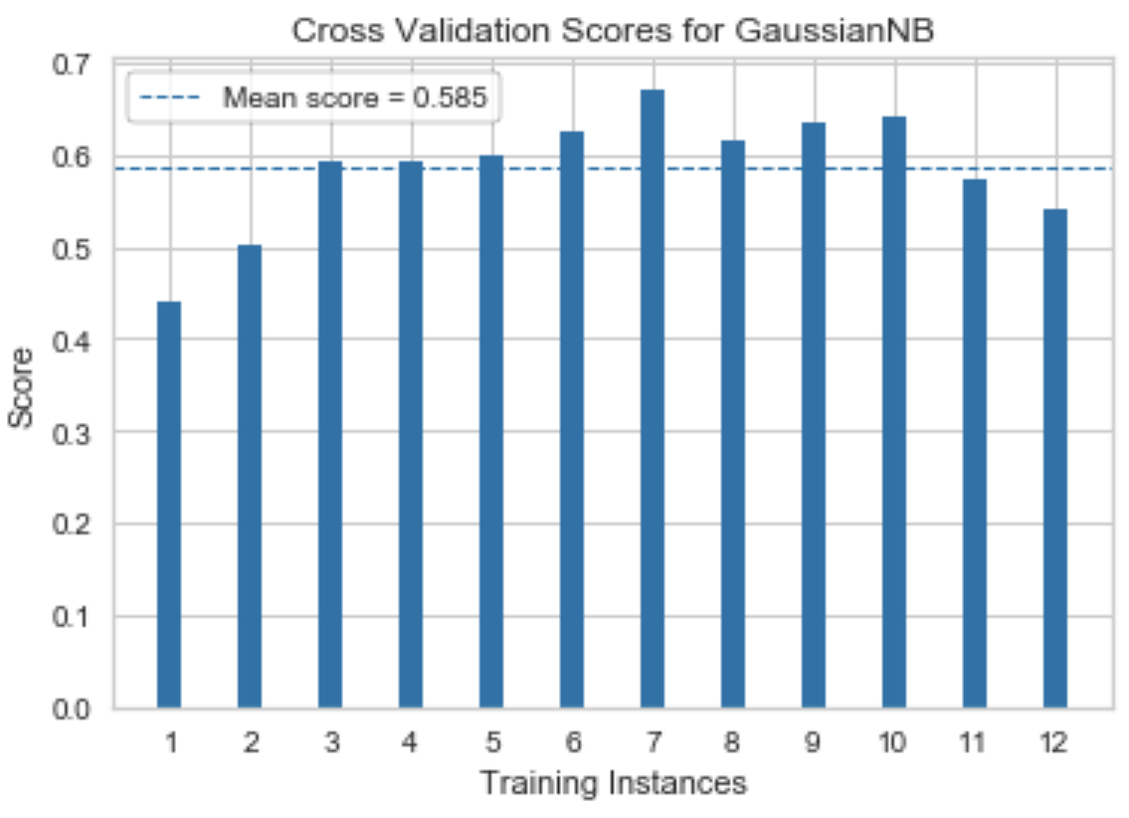
Classification Reports and CV – Baseline (examples)
Decision Tree
Gaussian NB

Slide 25
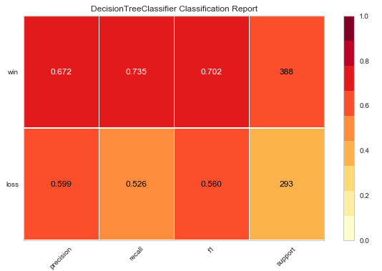
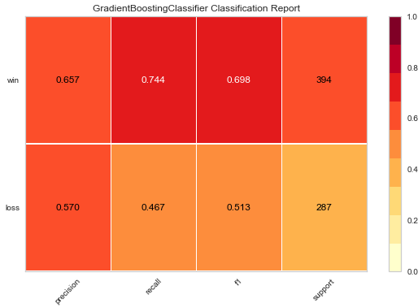
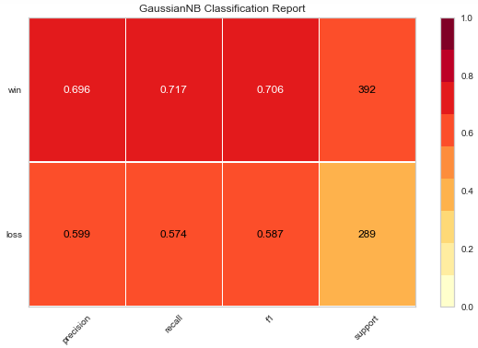
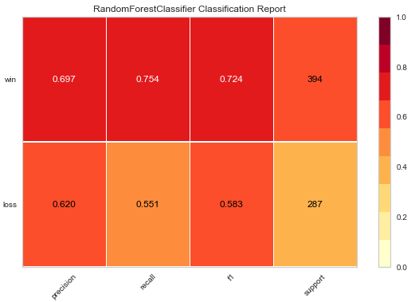
Classification Reports - Final Features
Gradient Boosting Classifier
Decision Tree
Gaussian NB
Random Forest Classifier

Slide 26

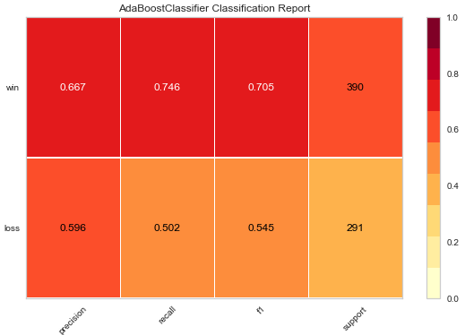
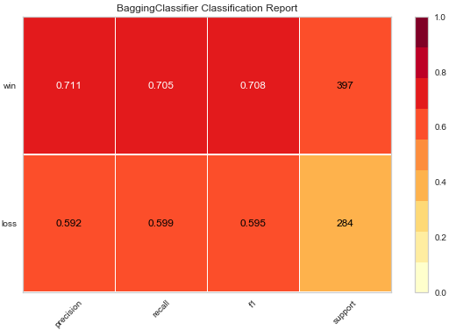
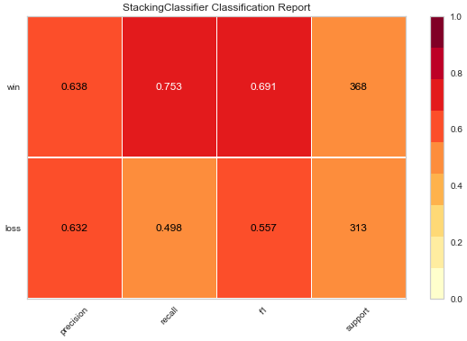
Classification Reports – Final Features
AdaBoost Classifier
Voting Classifier
Bagging Classifier
Stacking Classifier

Slide 27
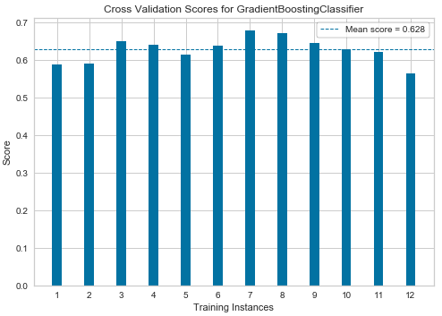
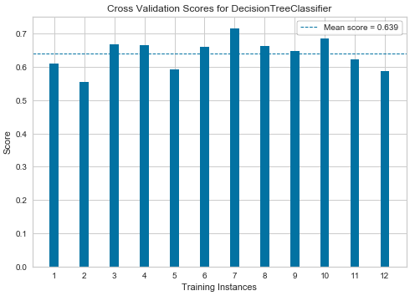
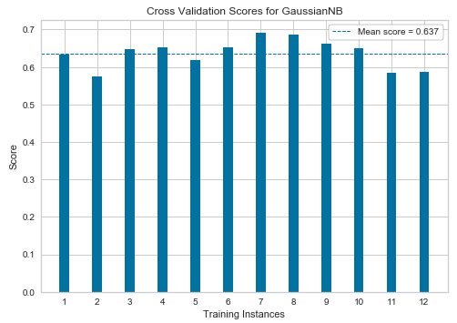
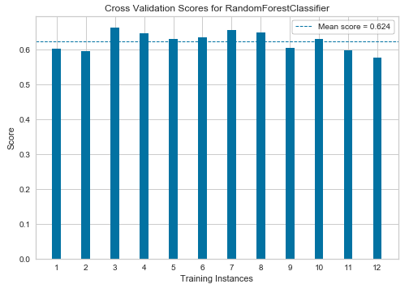

Cross Validation
Gradient Boosting Classifier
Decision Tree
Gaussian NB
Random Forest Classifier

Slide 28
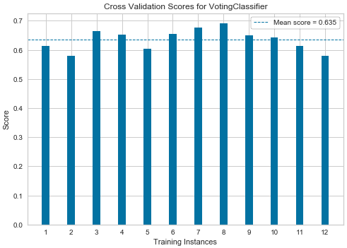
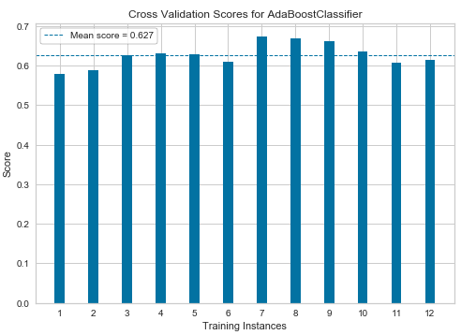
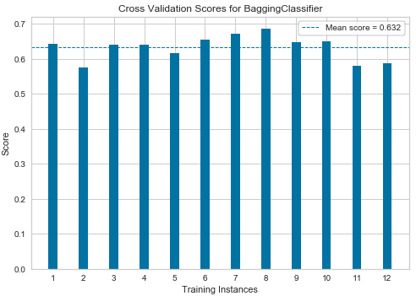
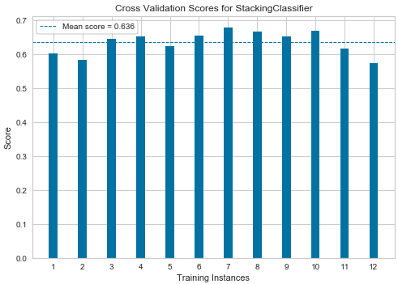
Cross Validation
AdaBoost Classifier
Voting Classifier
Bagging Classifier
Stacking Classifier

Slide 29
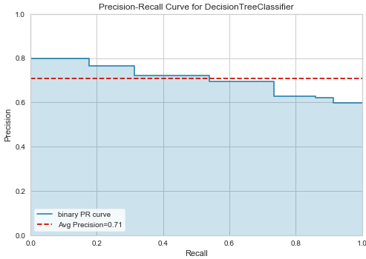
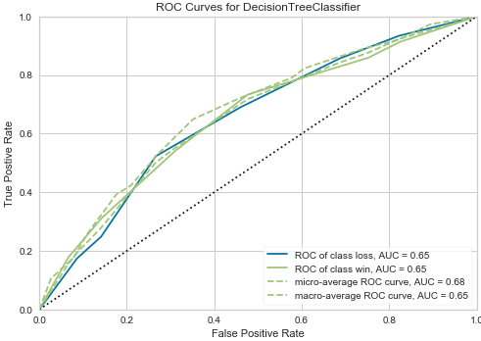
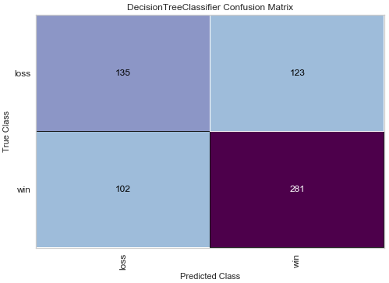
Decision Tree Classifier: 2002-2017 Data

Slide 30

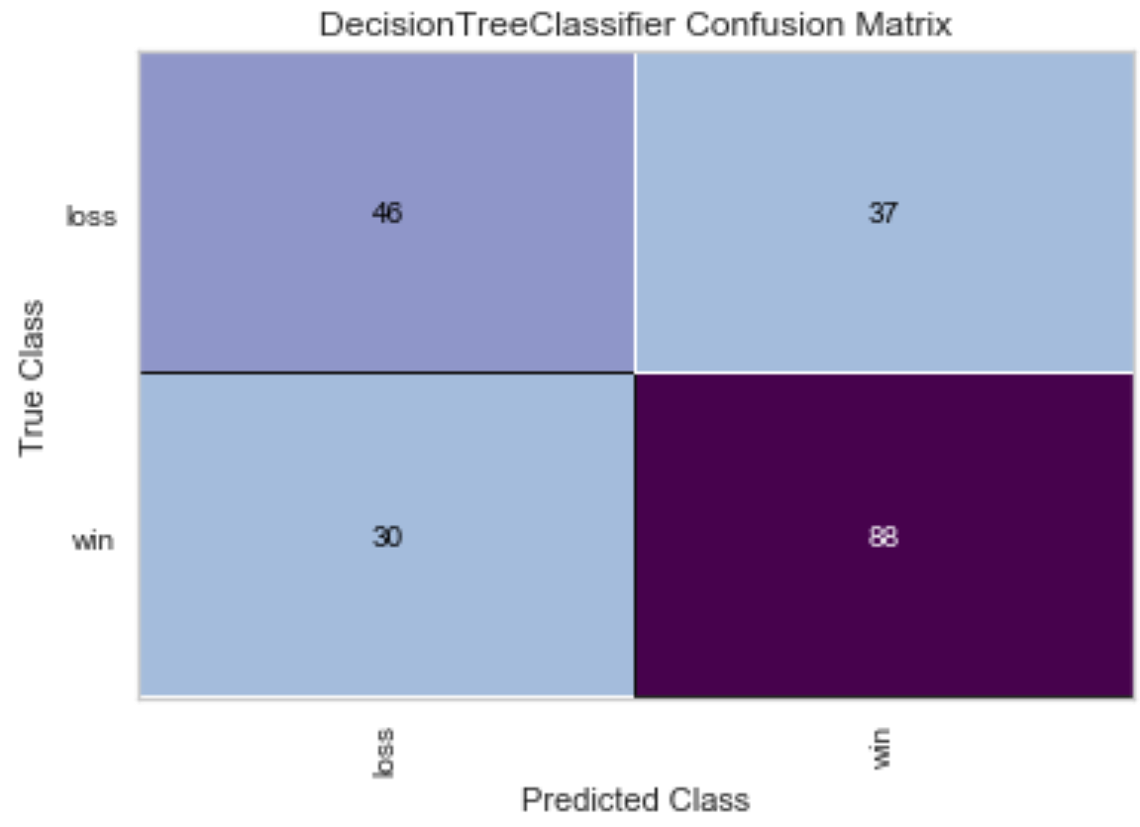
Decision Tree Classifier: Predicting on 2018 Data
We used the model to predict the 2018 results
The results show that we have an overall accuracy of 66.6%. The recall rate for predicting wins is 74.6%

Slide 31
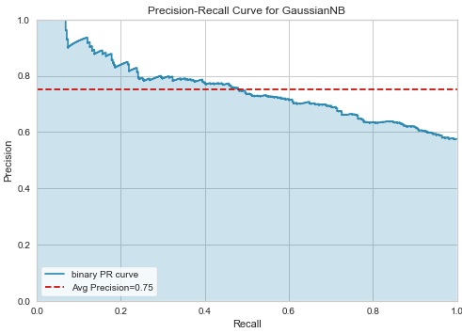
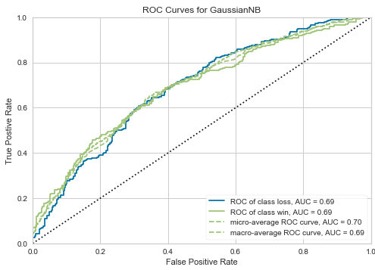
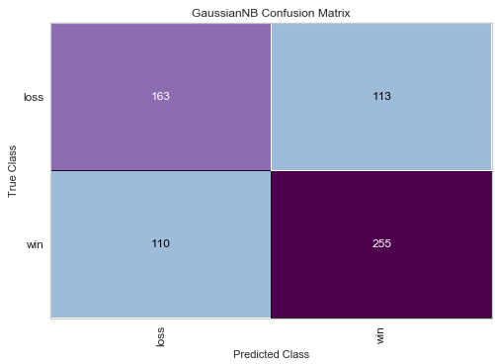
Gaussian NB: 2002-2017 Data

Slide 32
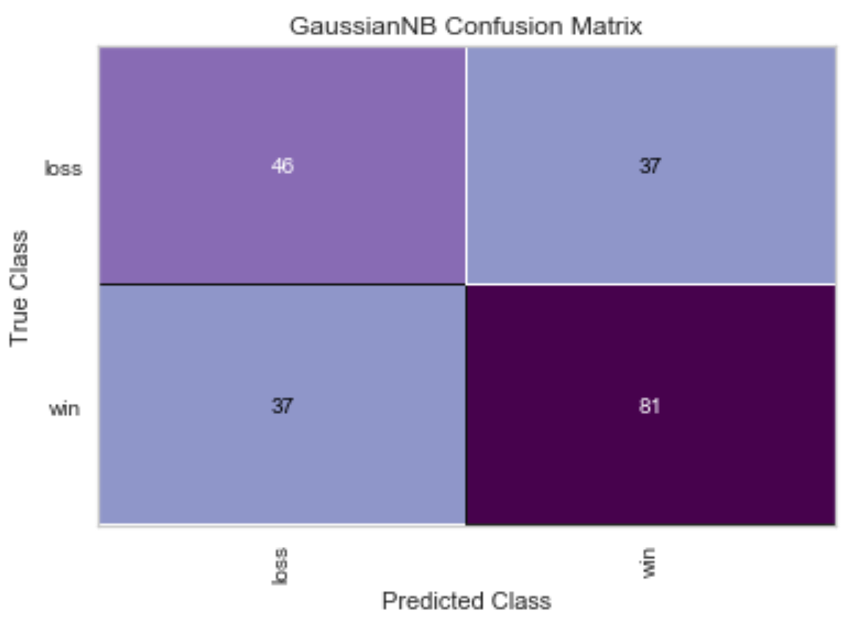
Gaussian NB: Predicting on 2018 Data
We used the model to predict the 2018 results
The results show that we have an overall accuracy of 63.2%. The recall rate for predicting wins is 68.6%

Slide 33
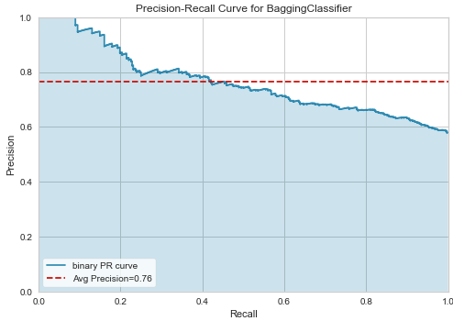
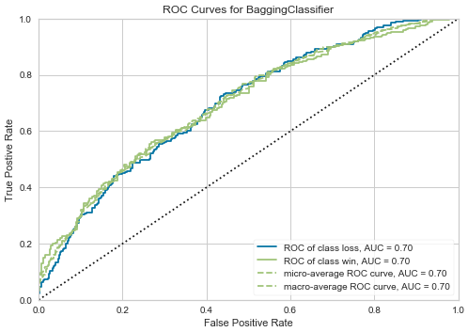
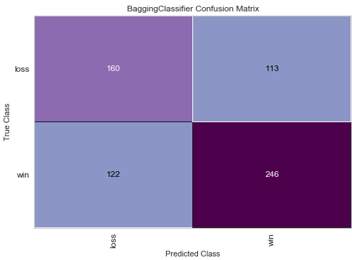
Bagging Classifier: 2002-2017 Data

Slide 34
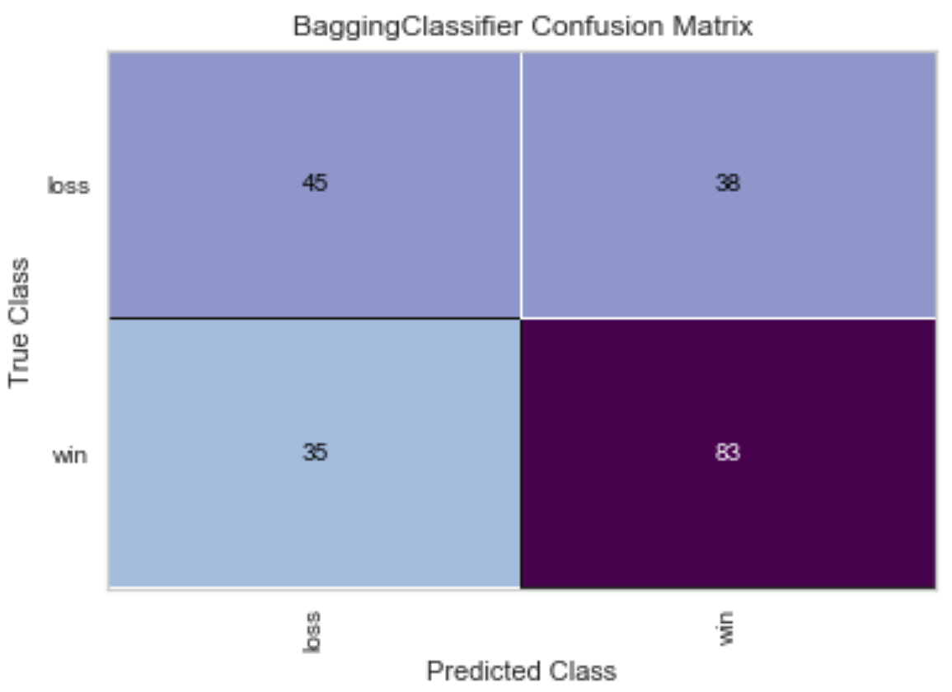
Bagging Classifier: Predicting on 2018 Data
We used the model to predict the 2018 results
The results show that we have an overall accuracy of 63.7%. The recall rate for predicting wins is 70.3%

Slide 35
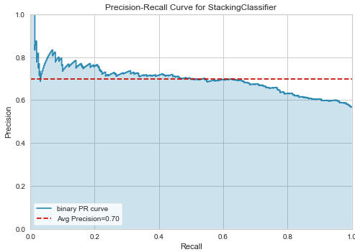
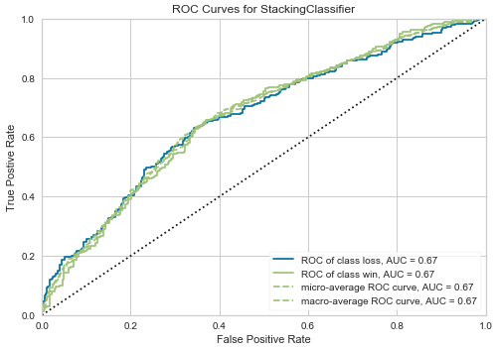
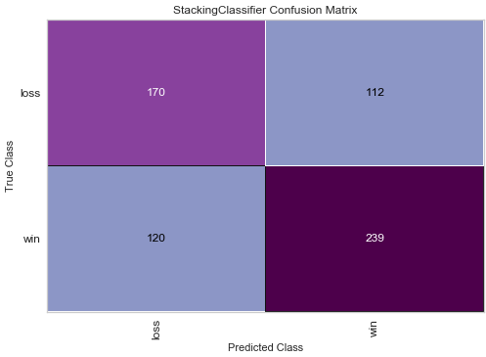
Stacking Classifier: 2002-2017 Data

Slide 36
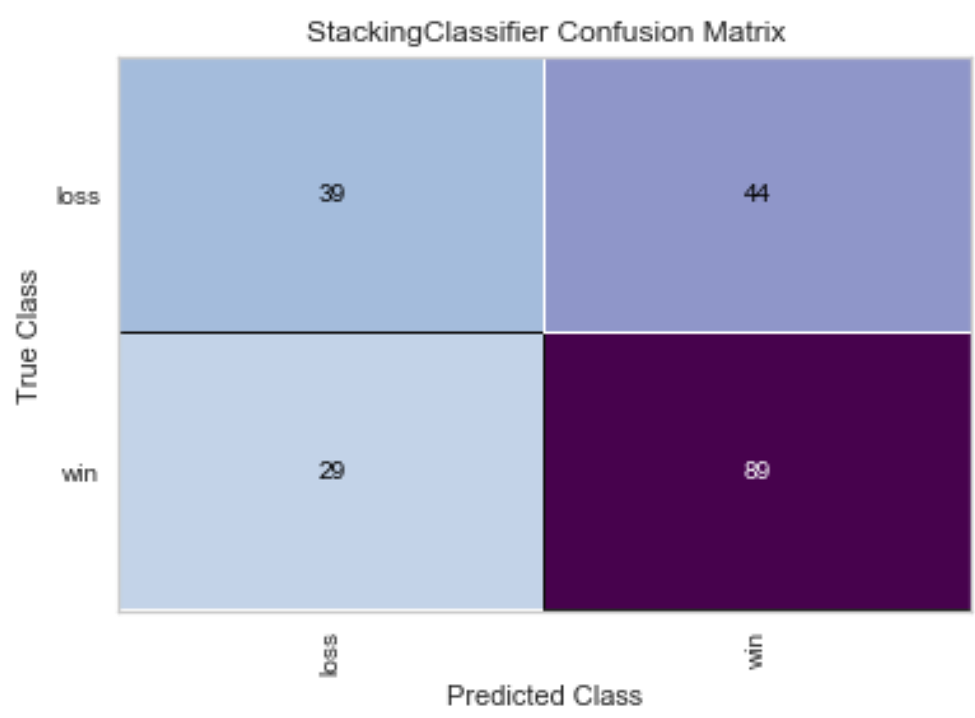
Stacking Classifier: Predicting on 2018 Data
We used the model to predict the 2018 results
The results show that we have an overall accuracy of 63.7%. The recall rate for predicting wins is 75.4%

Slide 37

Future Direction and Limitations

Slide 38
Future Direction and Lessons Learned
Future Direction
Acquire more data
Weather, dome vs. outdoors, increased granularity
Improve current data quality
Lacked fumble data due to error with PFR website scraping
Factor in player attributes
How many All-Pros / Pro Bowlers? Average age?
Lessons Learned
Remember to ask questions when it goes beyond level of ability
Utilize version control better
Project management and task delegation
Strategy for teaching others as you go to bring everyone along

Slide 39

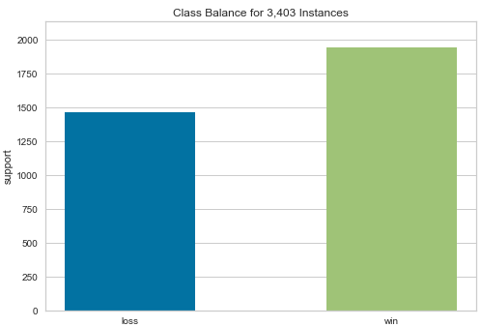
Limitations
Home_outcome = imbalance of wins vs. losses (Apparent bias in predicting wins over losses?)
No fumble data meant turnover_differential only partly helpful

Slide 40
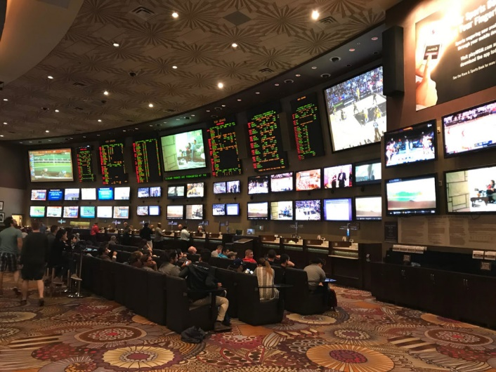

Thank you to all the instructors and everyone involved. The experience was truly invaluable. Next stop Vegas baby!
Q&A

Slide 41
Modeling Demonstration if there is time

